Slide 1
SENSORS
Dr. Archana Sharma

Slide 2
INTRODUCTION

Slide 6
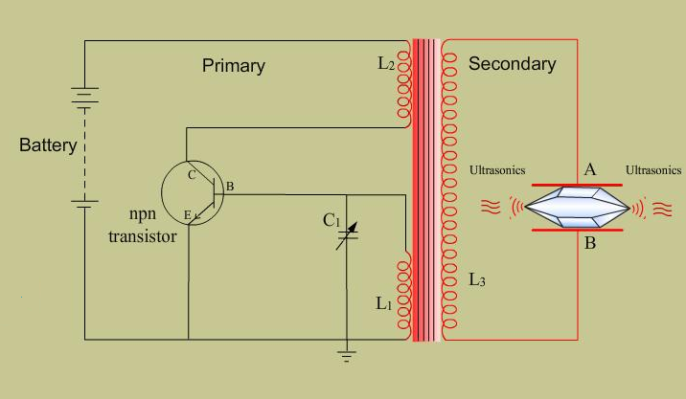
PIEZOELECTRIC OSCILLATOR

